Slide 1
RBAC In Spinnaker
Application vs. Account permissions
@twitter

Slide 2
What does spinnaker support?
Authentication Services (Who are you):
OAuth2, SAML, LDAP, Basic Form, X509
Authorization Services (What can you access):
External (from Authorization requests), G-Suite, GitHub, LDAP
Cautions:
Groups are ONLY supported - no username based auth
can’t mix oauth2 & Saml auth, but can mix x590 & saml
Notes:
Call to action: Invite other Authorization services, enhanced support & docs

Slide 3
Auth Architecture
Different workflows, but
<gate-api>/auth/user - if blank, redirect to login
Login posts back to one of the various login endpoints
Login PUTs to Fiat (the rbac system) “/authorize/user@email” with information
Fiat tracks groups & permissions for users in a cache

Slide 4
A bit about groups….
For large numbers of groups, most IDP (identity providers) limit the number of groups per login
LDAP does not
Can mix LDAP Groups with SAML/OAUTH2 logins
“Admin” groups are managed in configuration
You LIKELY will hit issues though with large groups
Notes:
Discuss limits of:
Azure
Okta
LDAP & Microsoft
How external groups are merged with fiat
Headers on requests including group information

Slide 5
Accounts
Account permissions are set in configuration. They are fixed (minus when using a dynamic service)
They are independent of application permissions.
Only support read/write
Accounts abstract away access to a cloud provider
This is often confusing to new users.
Spinnaker permissions do NOT have any impact on permissions in the cloud account!
Permissions in a target account can break spinnaker ability to communicate with these accounts!
Notes:
Kubernetes, even when setting “namespaces” limits, does NOT prevent a deployment from targeting OTHER namespaces if a manifest has configuration for it.
Discuss AWS permissions where a missing access to region API call caused caching of that AWS account to completely fail. Can also talk about K8s caching errors on restrictions on certain calls.

Slide 6
Account permissions
providers:
kubernetes:
enabled: true
primaryAccount: k8s-namespace-dev
accounts:
- name: k8s-namespace-prod
kubeconfigFile: encryptedFile:k8s!n:kubeconfig!k:kubeconfig
namespaces:
- prod
permissions:
READ:
- everyone
WRITE:
- engineering-managed
- name: k8s-namespace-dev
kubeconfigFile: encryptedFile:k8s!n:kubeconfig!k:kubeconfig
namespaces:
- dev
permissions:
READ:
- everyone
WRITE:
- everyone
Notes:
Note that only engineering-managed” has permissions to “prod”

Slide 7
Watch your cloud targets!
Scope permissions for your providers to ONLY what you want deployed
Kubernetes: namespaces configuration does NOT restrict deployments to other namespaces!
AWS regions config does NOT prevent deploys to another region, just prevent caching regions.
The above can have subtle impacts on how UI shows resources and how deploys operate!

Slide 8
Applications
Application permissions can be set in an application and changed on the fly
Can control with a policy as well via configuration
Support READ, WRITE, EXECUTE, CREATE (create primarily in configuration policy)
Impact is to pipelines & orchestrations ONLY
Default is “anyone can do anything”
Notes:
Talk about how a k8s deployed to a namespace didn’t plan for and wasn’t defined in manifest. That since that account didn’t INCLUDE the namespace (was the spinnaker namespace), saw no pods in the cluster view.
Can ask for PR’s to improve this one!

Slide 9
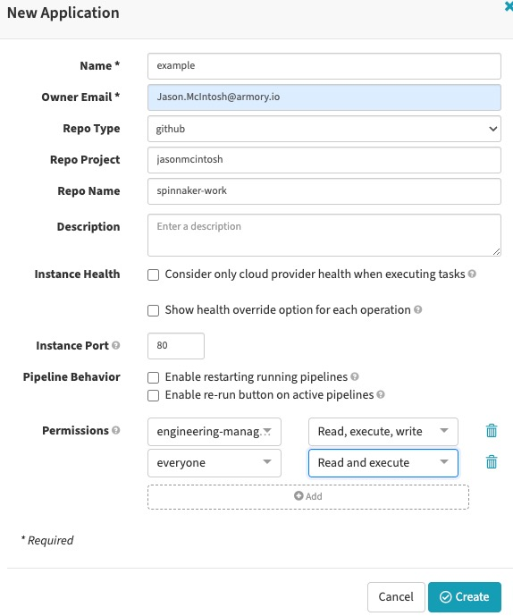
Application permissions
Set when creating an app or can be updated at anytime.
Updates to an app trigger a task to “sync” permissions which can take time to apply to all users.

Slide 10
Auth on executing a pipeline
Pipelines run with the permissions of the executor
Can assign permissions for automated triggers
Two methods:
Service Accounts
Pipeline Permissions
Both create an internal “service account” containing “roles” for the execution
Notes:
Discuss:
service account creation/management
Pipeline permissions
Performance impacts of LOTS of pipeline permissions, recent changes to dedupe them.
Assignment is tied to the user - can’t assign a permission unless you’re in ALL the groups for a given service account
Updating pipeline permissions similarly is restricted

Slide 11
In practice!
You need to configure both account & app permissions appropriately
They work together to help secure resources
Many resources, like artifacts, do NOT have permissions! E.g. GitRepos are not restricted to any groups

Slide 12
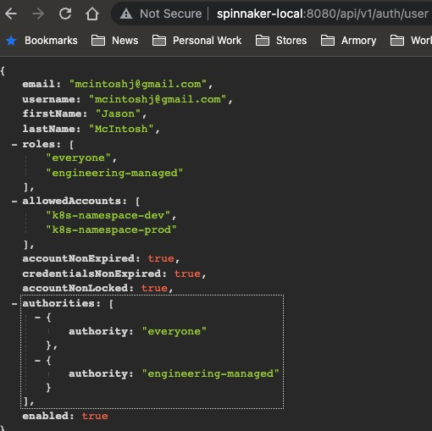
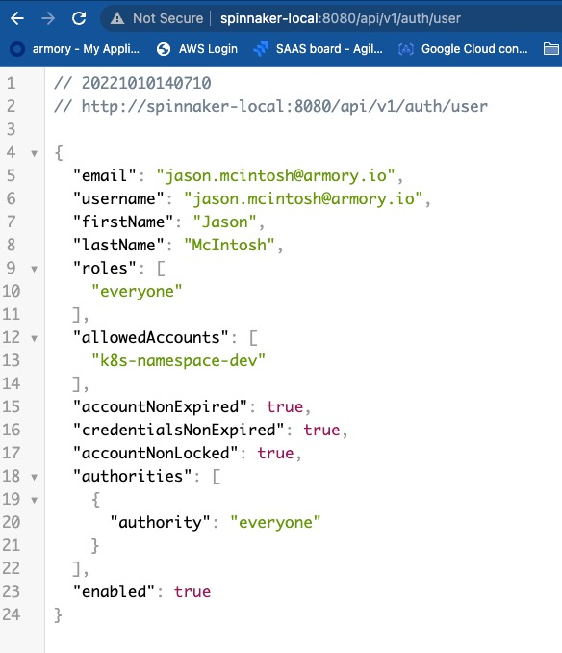
Let’s put it together…
An “Admin” user
A “normal” user
Notes:
Show the roles difference.

Slide 13
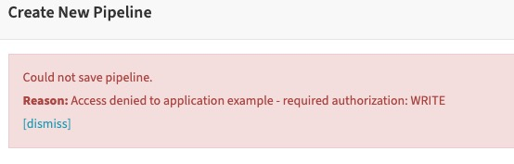
What happens next…
Users only in “Everyone” can’t create a pipeline

Slide 14
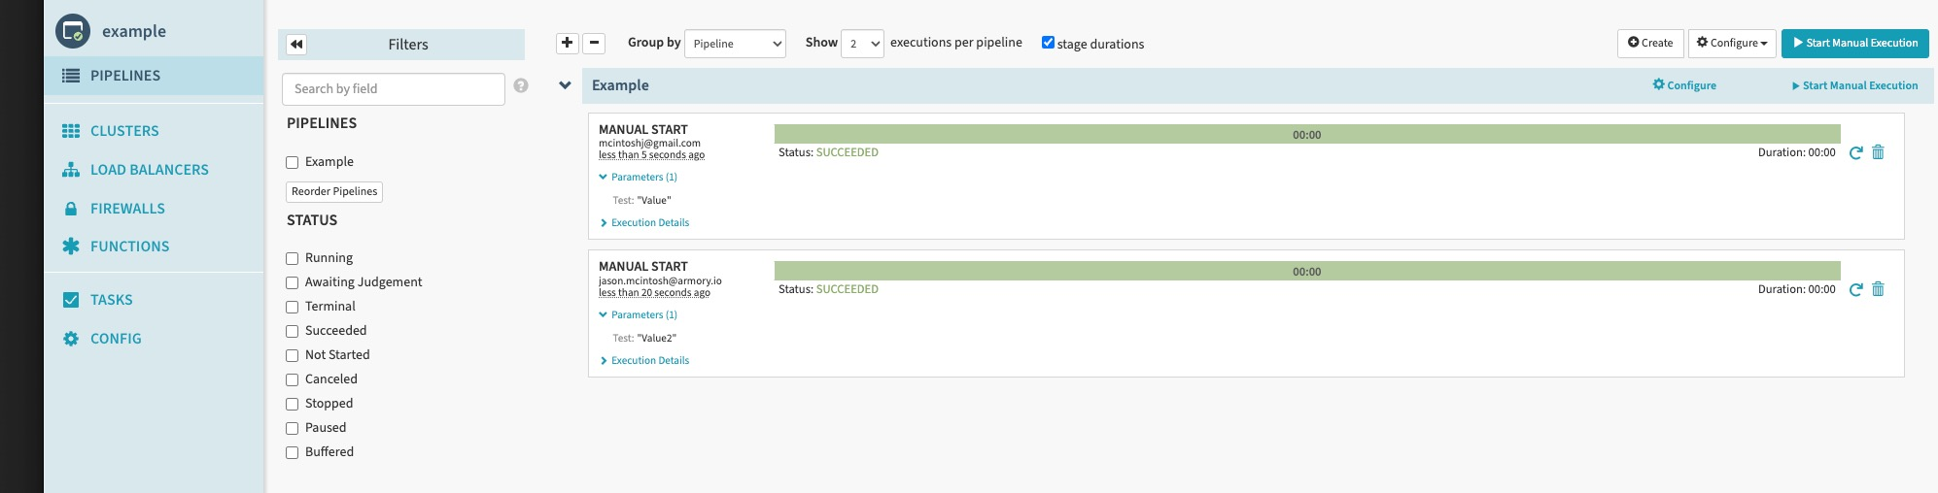
Executing a pipeline…
Both users can execute a pipeline
AS LONG AS: No accounts are deployed to

Slide 15
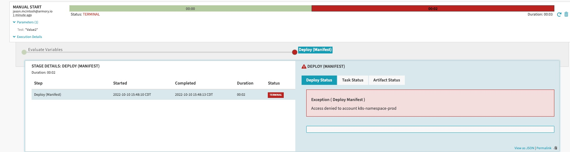
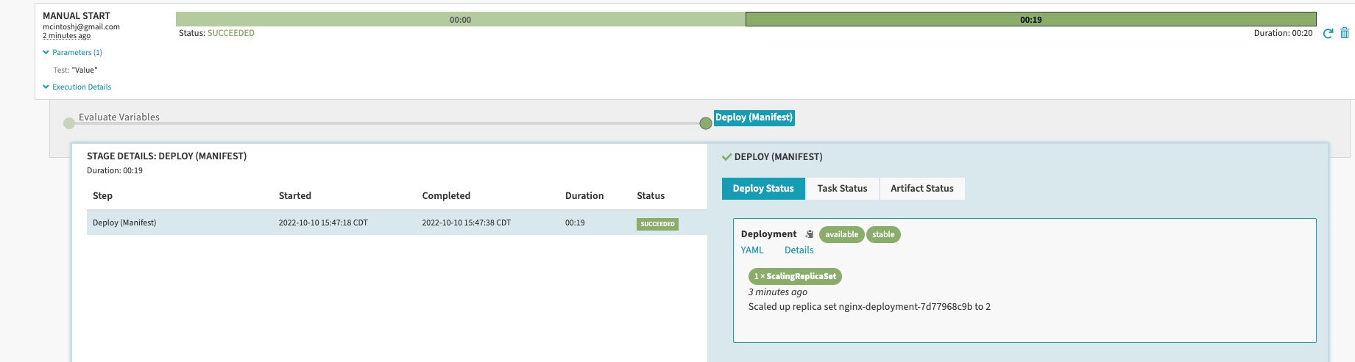
But… for prod …
Users without WRITE Permissions to an ACCOUNT can run… and fail

Slide 16
How to let control access to prod?
Manual judgement permission propagation
Automated Triggers - These are great for full CD

Slide 17
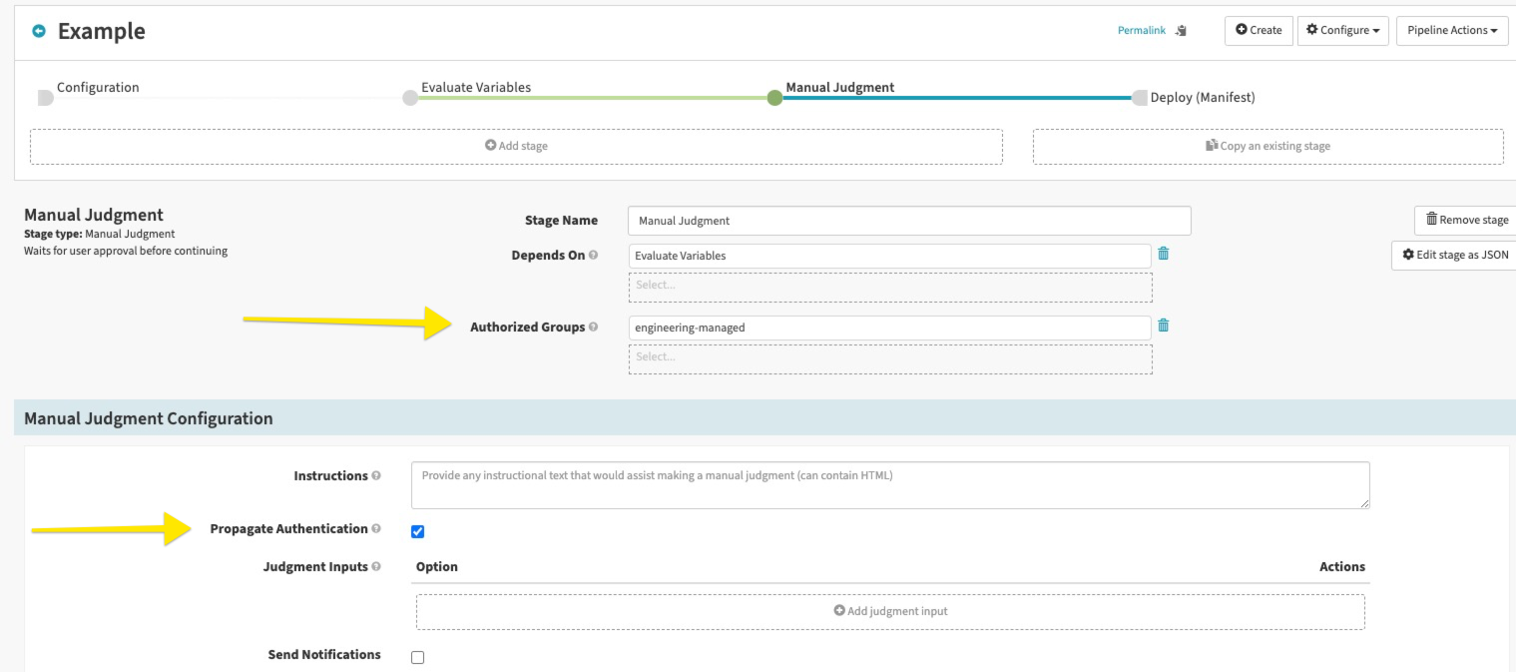
Manual Judgement Permissions
Add a manual judgement which allows a privilege change by a “Managed member”.

Slide 18
Automated Triggers
Automated triggers can use a fake internal user
The pipeline runs with the roles of this fake user
Have to be a member of ALL groups to assign the user to a pipeline trigger!
READ IS NOT defaulted! Recommend adding groups to read AND write, not just WRITE

Slide 19
Automated Trigger Permissions
Pipeline Permissions, easiest to use to enable RBAC
Unique per pipeline (flag can change this for dedupe)
Updating a pipeline MAY require a “sync” which is expensive operation
Changes the field in the pipeline JSON “roles” vs. “runAs”
LOTS Of these users increasing sync time cost
Service Accounts - older style, have to be pre-defined.
Advantage is predefined roles, no need to figure out what per pipeline
Still has same restrictions on assignment to a pipeline
Results in fewer service accounts
Harder to change dynamically as requires internal API call
Recommend using pipeline permissions as a rule

Slide 20
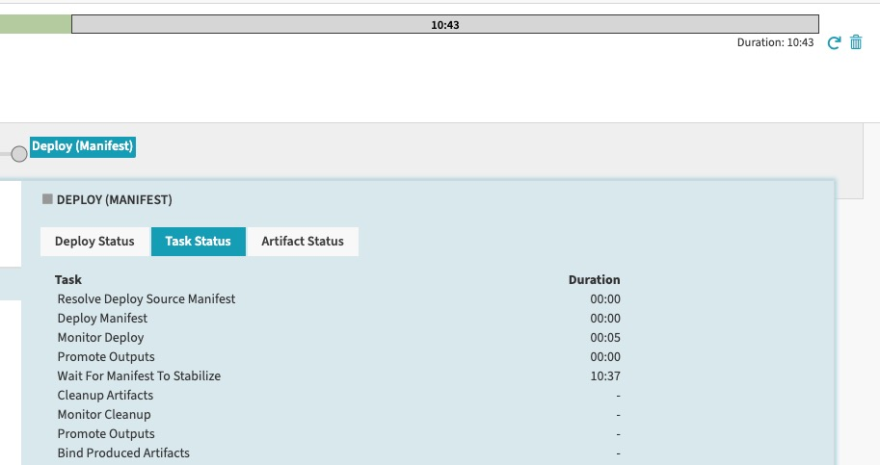
Danger zone!
Read is not default, so granting only write can cause weird errors/situations!
Example:
Grant “managed” to WRITE, but not READ
Create a pipeline with “managed” as having permissions.
Pipeline runs, can deploy… but can’t read the status to know if it succeeded!
Example logs from clouddriver:
2022-10-10 22:25:42.324 ERROR 1 --- [0.0-7002-exec-5] n.s.f.s.FiatAccessDeniedExceptionHandler : Encountered exception while processing request GET:/manifests/k8s-namespace-prod/prod/deployment%20nginx-deployment …. x-spinnaker-user=161649b6-78da-47af-a245-3908f60761e2@managed-service-account
org.springframework.security.access.AccessDeniedException: Access is denied
A pipeline trigger role MUST ALSO have execute permissions in the App itself or it can’t even fire, no error shown!
Spinnaker does NOT validate your permissions will work!
Syncs MAY be required post change - and can take a while!
Notes:
DOcument how i hit it…

Slide 21
Some policy driven controls…
Documented: https://docs.armory.io/armory-enterprise/armory-admin/fiat-create-permissions/
auth.permissions.provider.application: aggregate
auth.permissions.source.application.prefix:
enabled: true
prefixes:
- prefix: "apptest-*"
permissions:
READ:
- "role-one"
WRITE:
- "role-one"
EXECUTE:
- "role-one"
Can use this to block/control permissions and override app local settings. This config TAKES PRECEDENCE!

Slide 22
What’s coming?
Number of improvements to Fiat & Processing
Auth to artifacts - would welcome PRs!
Orchestration tasks (vs pipelines) and restricting permissions
Reducing “sync” time to be more efficient

Slide 23
References
Github Repo: https://github.com/jasonmcintosh/spinnaker-work
Create permissions restriction: https://docs.armory.io/armory-enterprise/armory-admin/fiat-create-permissions/
Authorization docs: https://spinnaker.io/docs/setup/other_config/security/authorization/
Authentication docs:https://spinnaker.io/docs/setup/other_config/security/authentication/
X509 walkthrough: https://docs.armory.io/armory-enterprise/armory-admin/api-endpoint/
Permissions matrix: https://docs.armory.io/armory-enterprise/overview/fiat-permissions-overview/

Slide 24
Q&A?
Work: jason.mcintosh@armory.io
Personal: mcintoshj@gmail.com
Twitter: https://twitter.com/mc717990

